Slide 1

Where is data visualization going?
a personal perspective
Clément Levallois
EMLYON Business School
2nd DataStorm Big Data Summer School, 15 July, 2015, Lisbon

Slide 2
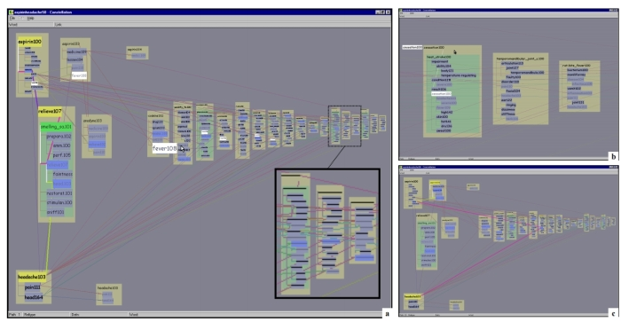

Slide 3
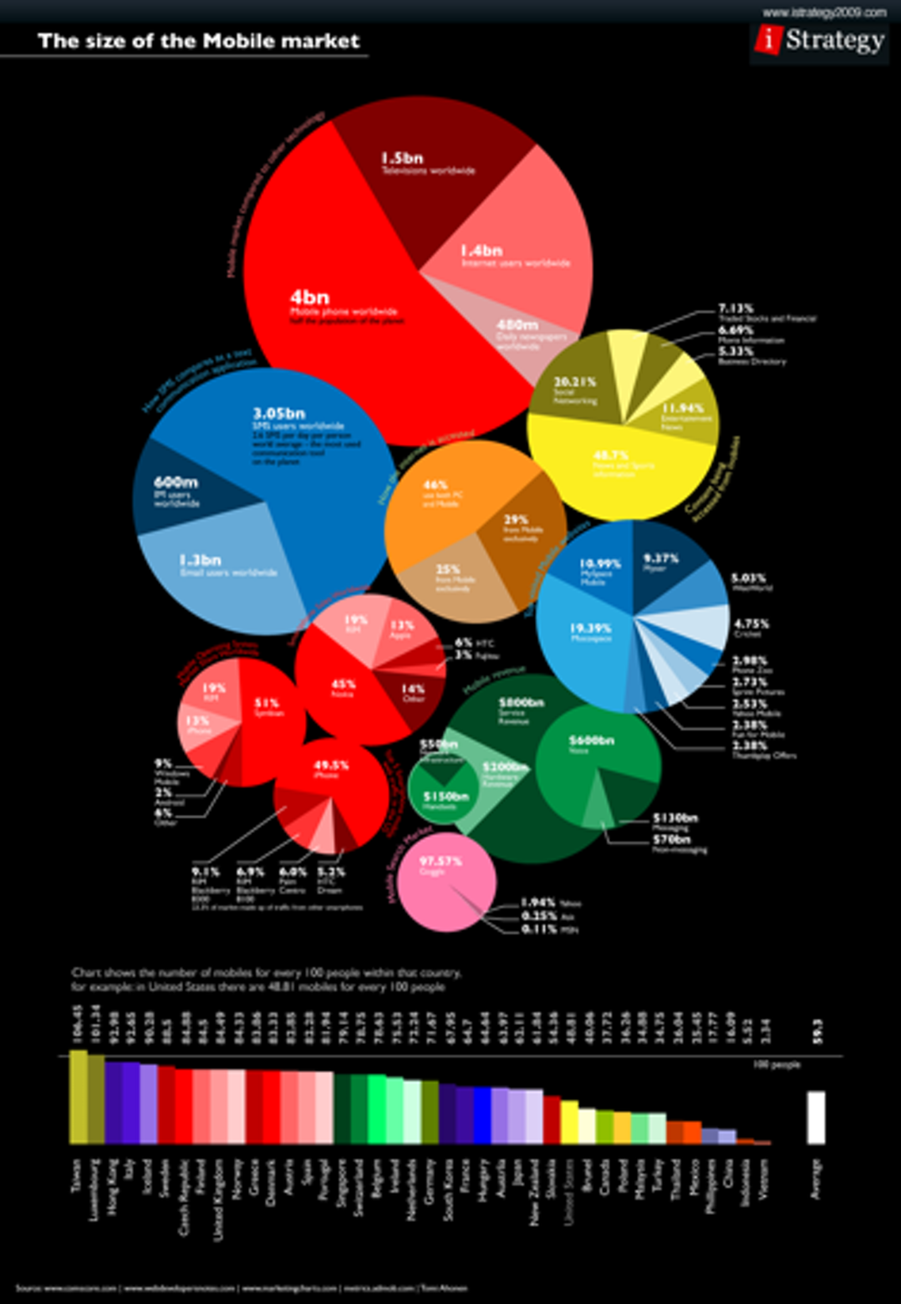

Slide 4
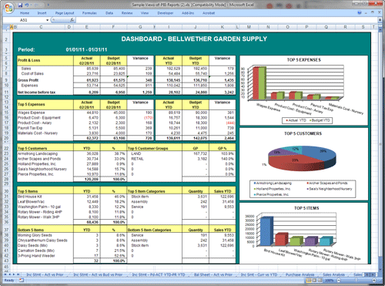

Slide 5
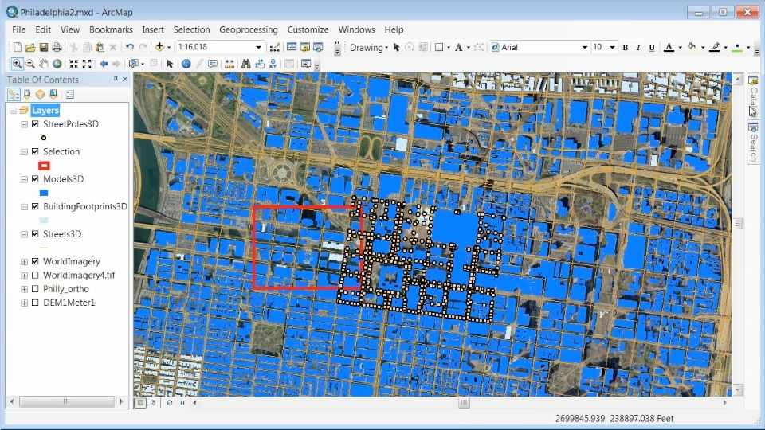

Slide 6


Slide 7
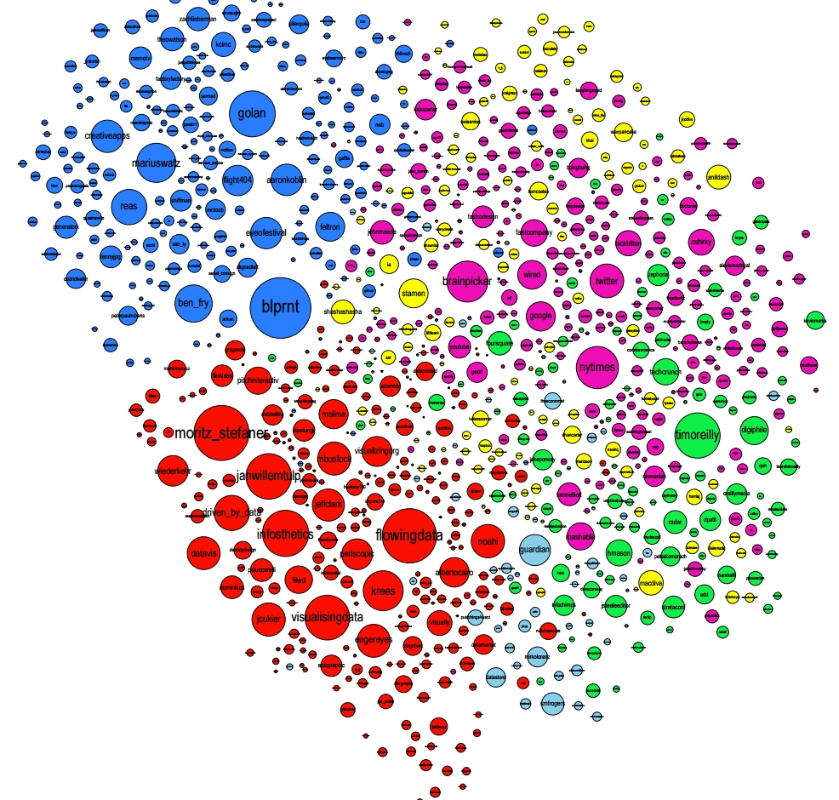
Media
companies
Art / Design/
Eyo Festival
Data visualization
Data science

Slide 8
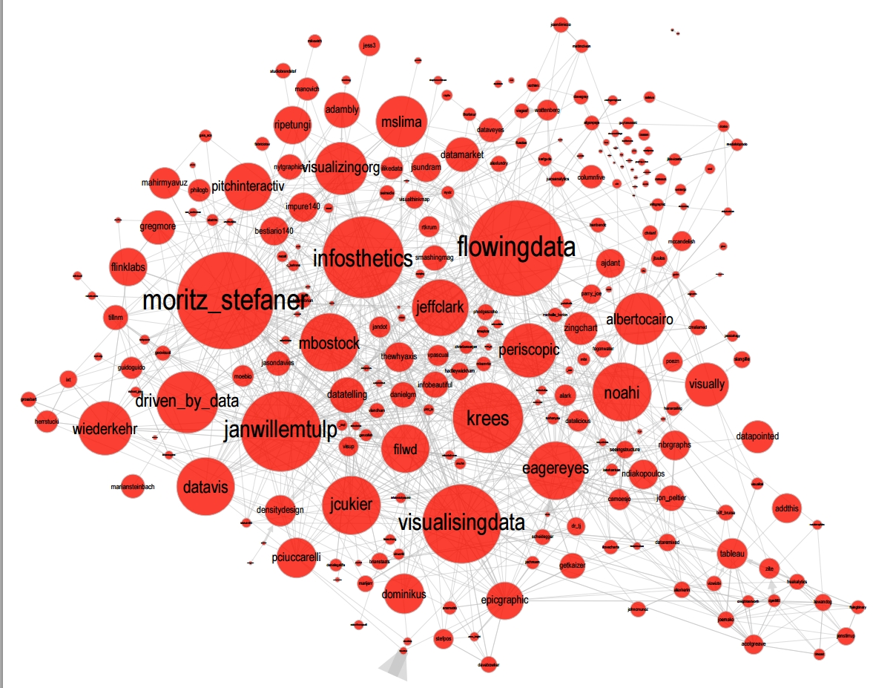

Slide 9
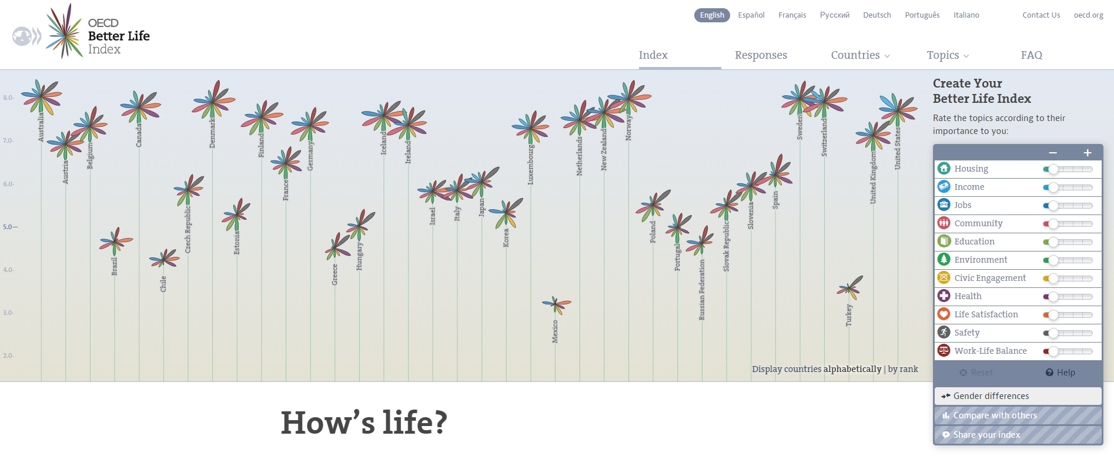

Slide 10
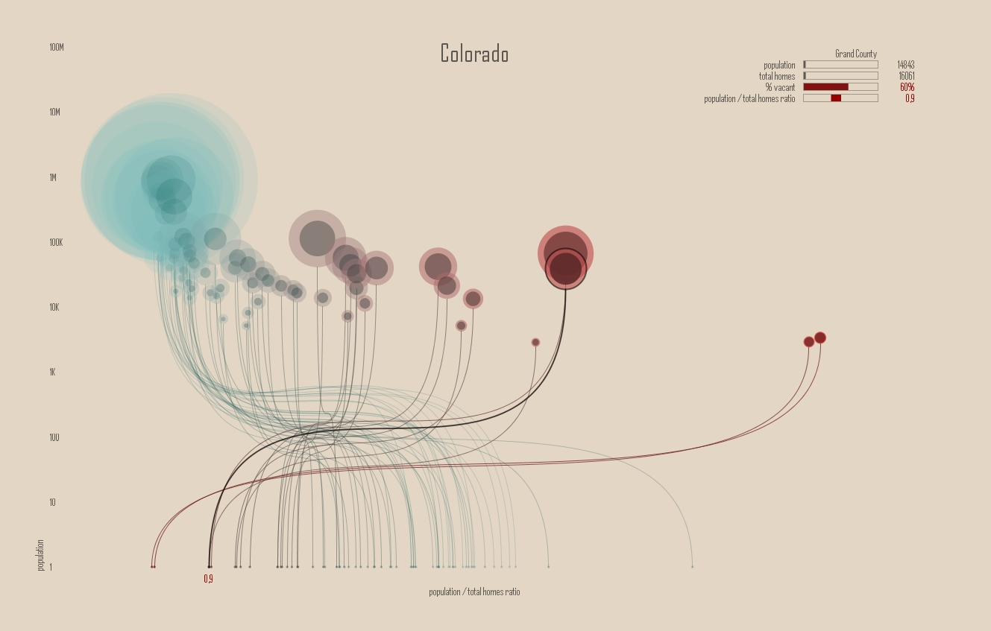

Slide 11
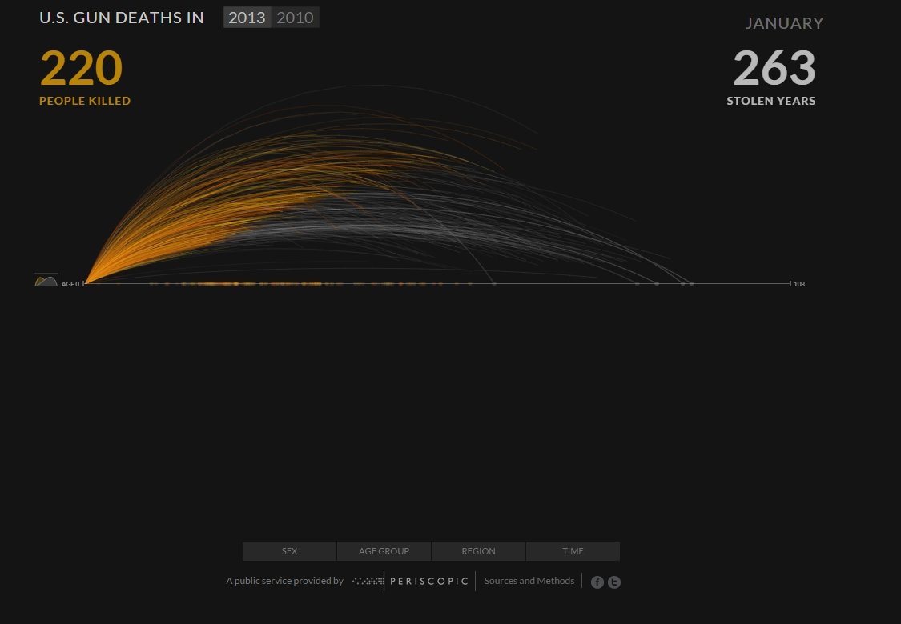

Slide 12
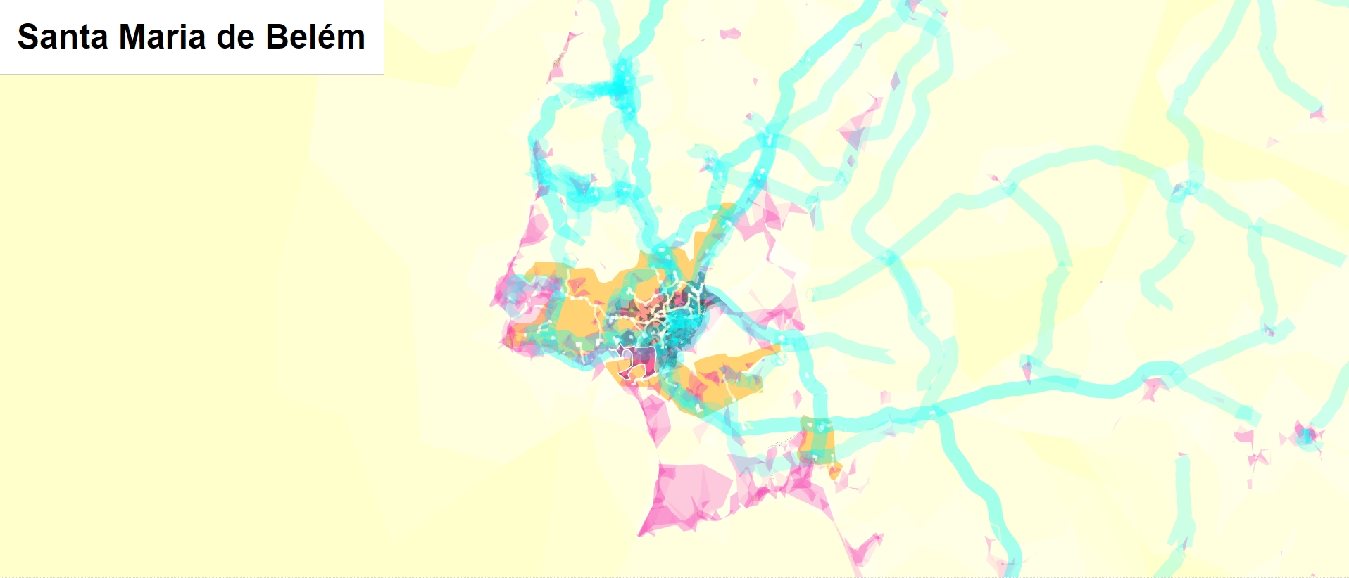

Slide 13
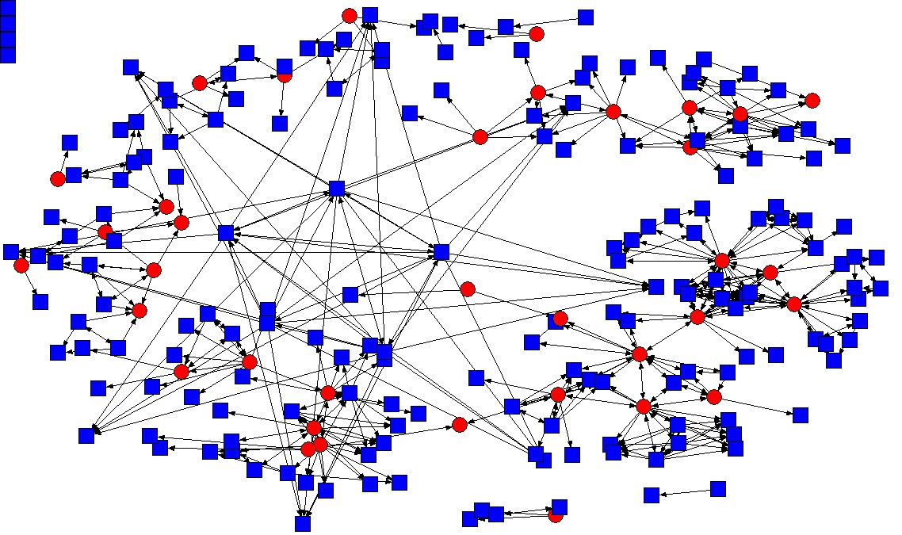

Slide 14
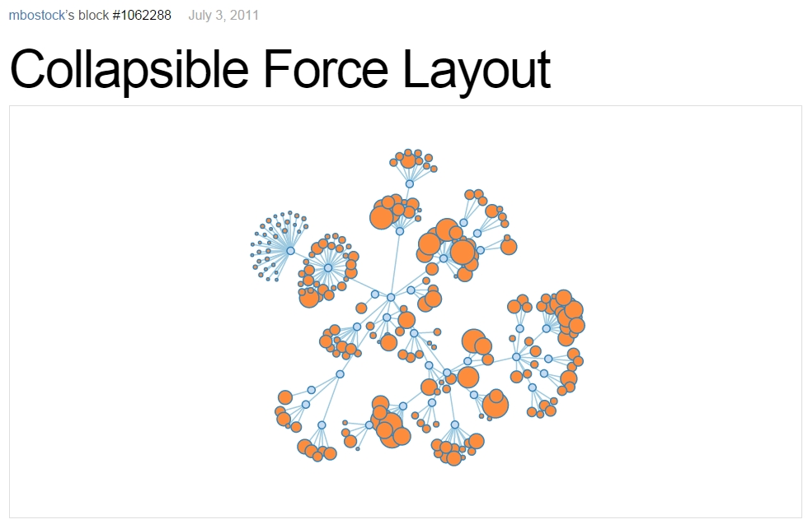

Slide 15
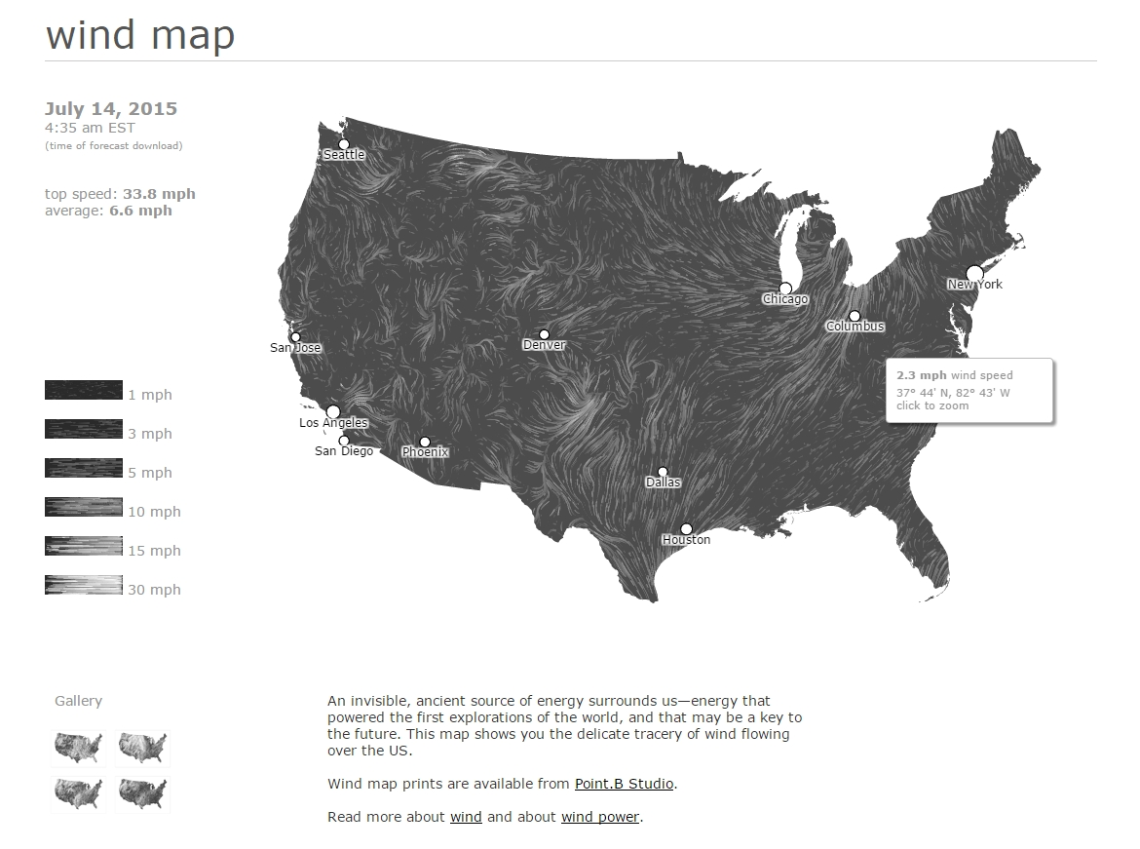

Slide 16


Slide 17
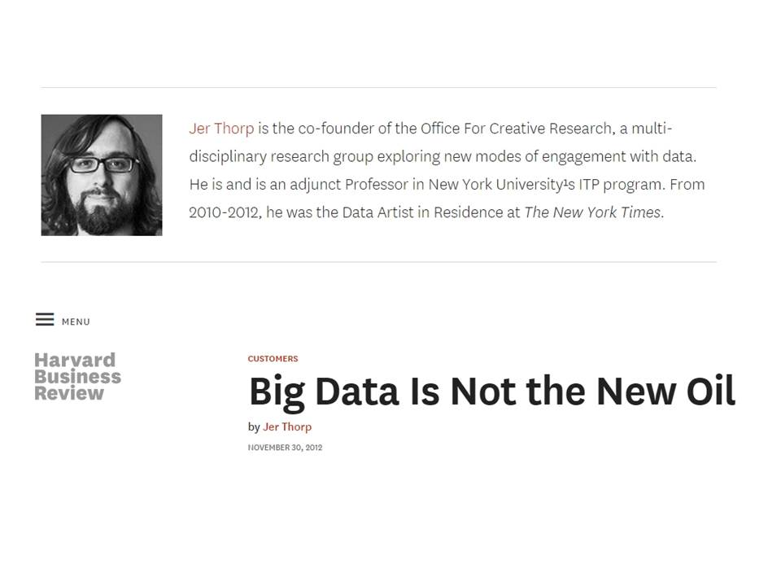

Slide 18


Slide 19
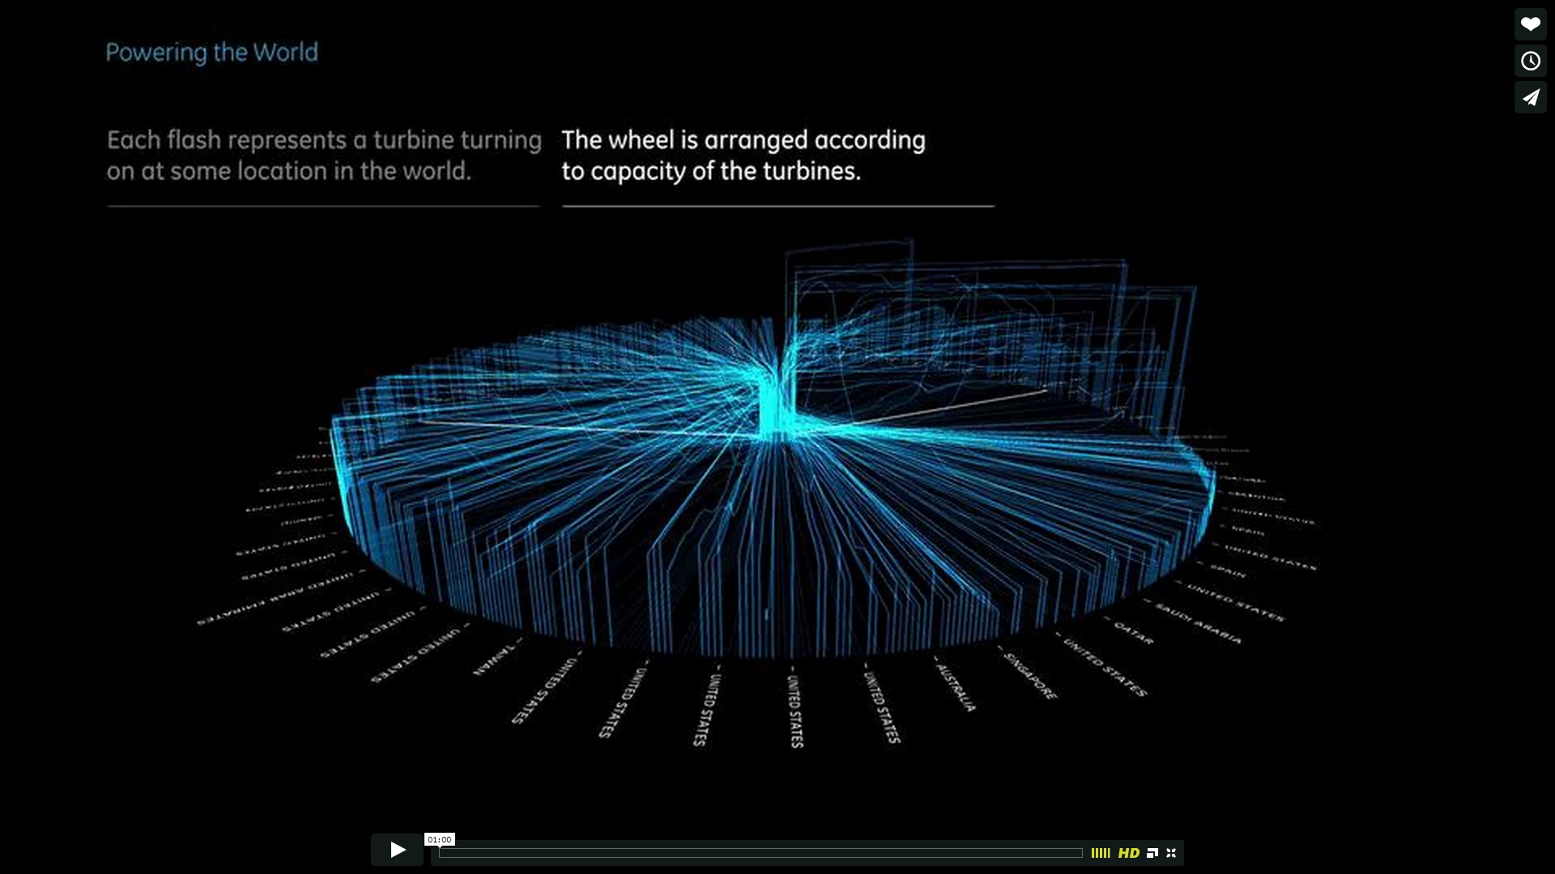

Slide 20
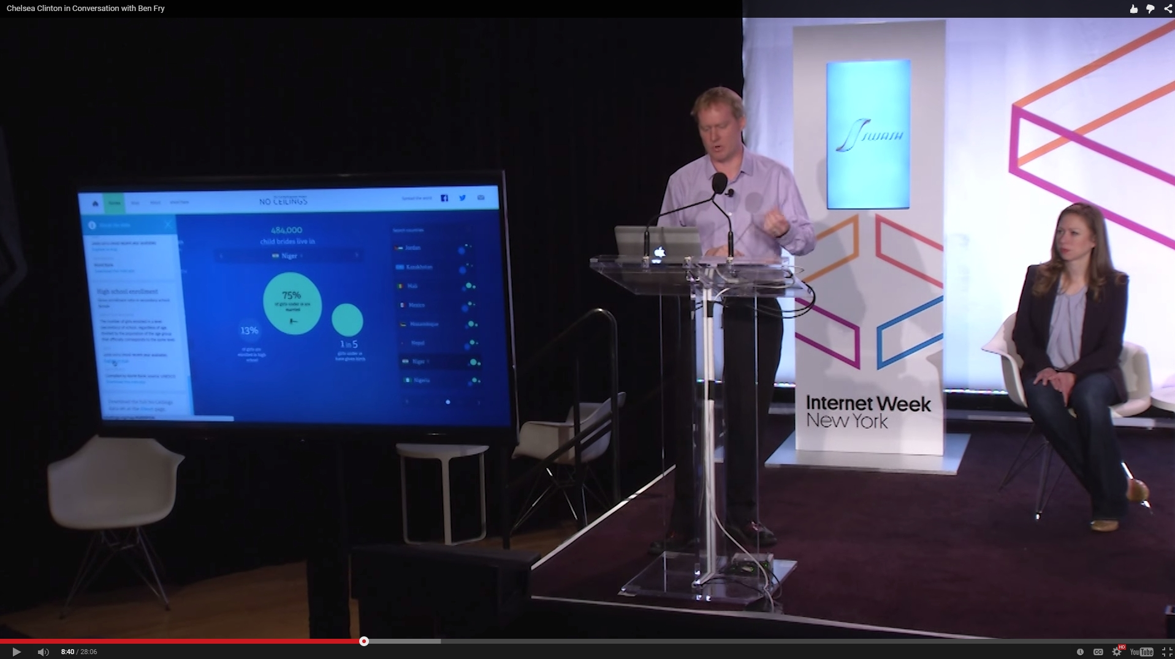

Slide 21
Thank you
This talk is online at
www.clementlevallois.net
@seinecle

